Slide 1
Introduction to Bootstrap 4

Slide 2
Bootstrap
Bootstrap is a free and open source web front-end framework that brings quality, speed and easiness to develop UI of web applications.
Bootstrap includes HTML and CSS design templates for typography, buttons, tables, navigation, modals, image carousels and many other, as well as optional JavaScript plug-ins.
It gives you ability to create responsive designs.
Its compatible with all modern browsers.
Notes:
http://www.w3schools.com/bootstrap/bootstrap_get_started.asp

Slide 3
How to Use Bootstrap?
Download from getbootstrap.com and include CSS, JS files in your project. http://getbootstrap.com/docs/4.0/getting-started/download/
In production, we often use CDN links e.g.
  <link rel="stylesheet" href="http://maxcdn.bootstrapcdn.com/bootstrap/3.3.6/css/bootstrap.min.css">
  <!-- jQuery library -->
  <script src="https://ajax.googleapis.com/ajax/libs/jquery/1.12.0/jquery.min.js"></script>
Once library is added in the web page, you can use the pre-defined CSS classes in page HTML.

Slide 4

.container
 | Extra small <576px | Small ≥576px | Medium ≥768px | Large ≥992px | Extra large ≥1200px
max-width | 100% | 540px | 720px | 960px | 1140px
Short Word Used | xs | sm | md | lg | xl

Slide 5
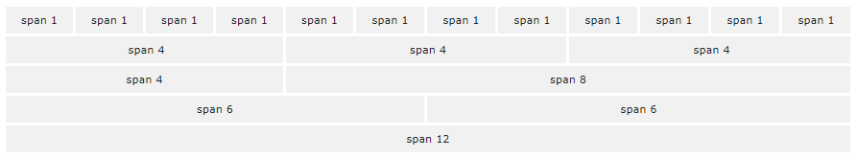
Bootstrap Grid System
Bootstrap's grid system allows up to 12 columns in a page or row.
We can group columns to make wider columns e.g. col-1, col-3, col-4, col-6, col-12 etc.
When defined properly, columns re-arrange depending on the screen size. It help to make responsive design.

Slide 6
Bootstrap Grid System
The grid system has four breakpoint selectors:
  xs (for phones) – no need to specify, its default
  sm (for small devices e.g. tablets)
  md (for medium sized screen e.g. desktops and laptops)
  lg (for larger desktops)
  xl (for extra large displays)
Grid breakpoints are based on minimum width media queries e.g. col-sm-4 applies to small, medium, large and extra large.

Slide 7
Grid Classes
.col- (extra small devices. width < 576px)
.col-sm- (small devices i.e. => 576px)
.col-md- (medium devices i.e. => 768px)
.col-lg- (large devices i.e. => 992px)
.col-xl- (xlarge devices i.e. => 1200px)

Slide 8
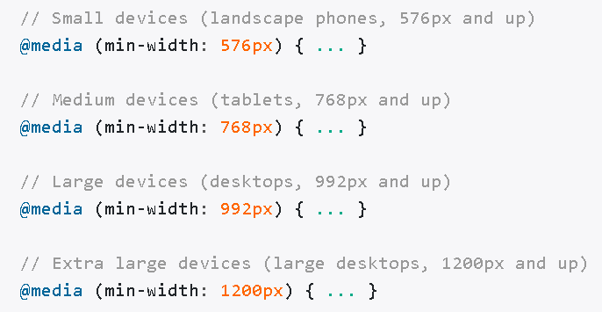
Bootstrap Uses Media Queries
No media query for `xs` since this is the default in Bootstrap.

Slide 9
Grid System Rules
Use .container for responsive pixel width or .container-fluid for 100% width
.row is wrapper for columns
Content should be placed in columns. Only columns may be immediate children of rows.
Predefined classes like .row and .col-sm-4 are available for quickly making grid layouts.
Notes:
http://blog.teamtreehouse.com/box-sizing-secret-simple-css-layouts

Slide 10
Grid System Rules
Box Model do not break because of box-sizing property. See col-md-* width and padding…
Columns create gutters (gaps between column content) via padding. That padding is offset in rows for the first and last column via negative margin on .row to avoid double gap e.g. container and row padding.
Grid columns are created by specifying the number of 12 available columns you wish to span. For example, three equal columns would use three .col-sm-4
Notes:
http://blog.teamtreehouse.com/box-sizing-secret-simple-css-layouts

Slide 11
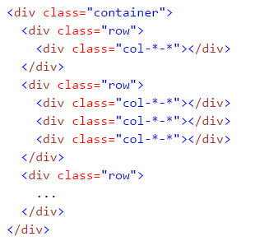
Structure of Web Page using Bootstrap

Slide 12
Sizing (m Margin)(p Padding)
t - for classes that set margin-top or padding-top
b - for classes that set margin-bottom or padding-bottom
l - for classes that set margin-left or padding-left
r - for classes that set margin-right or padding-right
x - for classes that set both *-left and *-right
y - for classes that set both *-top and *-bottom
blank - for classes that set a margin or padding on all 4 sides of the element

Slide 13
Sizing (m Margin)(p Padding)
0 - for classes that eliminate the margin or padding by setting it to 0
1 - (by default) for classes that set the margin or padding to $spacer * .25
2 - (by default) for classes that set the margin or padding to $spacer * .5
3 - (by default) for classes that set the margin or padding to $spacer
4 - (by default) for classes that set the margin or padding to $spacer * 1.5
5 - (by default) for classes that set the margin or padding to $spacer * 3
auto - for classes that set the margin to auto

Slide 14
Explore Yourself
https://getbootstrap.com/
https://www.w3schools.com/bootstrap4/default.asp

